Slide 1
Wholesale Management System
BY:
Sudarshan Deshmankar (002191198)
Vishesh Rawat (002192290)
Akshyakumar Karthikeyan (002198969)
Sushanth Sunder Metpalli (002922641)

Slide 2
Overview
Objectives
Problem Statement
Proposed Solutions
DATA MODEL E-R DIAGRAM
Demonstration
Data Flow Diagram

Slide 3
Objectives
To design a database for wholesale companies which can provide the following features: -
• Accuracy in maintaining data and inventory structure.
• Managing the product storage and summarize point of sales.
• To provide sales data for each day.
• To provide details on goods expiry dates.
• Eradicate the redundancies.
• To maintain the integrity of data.

Slide 4
Problem Statement
1. The existing system uses a manual inventory system to stock products, order, and purchase items.
2. The security level of data, documents related to transactions and inventory is low.
3. Existing data does not provide any records for expiration of food items.
4. Inadequate data and unstructured information are recorded, and data cannot be accessed because the records are stored in multiple files and formats.
5. Reports for total sales of the day are determined by the amount of money in the cashier deck, making it impossible to provide data to the owner for him to make sound business decisions.
6. Billing information, tickets, and coupons are not being handled correctly from wholesale to store.
7. Processing, adding, and managing are difficult tasks.
8. Time consuming, insufficient data on physical counts of products.
9. Missing daily orders data, insufficient data for predicting the supplies needed, and logistics are all factors that contribute to these challenges

Slide 5
Proposed Solutions
To overcome the above problems, a database model can be used. The solutions are: -
1. Instead of manually searching for logistics availability, usernames details, we can use Natural keys in databases to prevent users for redundancies and makes the data consistent.
2. With the database design, we can obtain the pricing and customer’s details by including the Customer ID and Product ID as PRIMARY KEY that identifies the records uniquely.
3. Using a database design, even though the Manufacturing ID and Sales ID are different, we can join the two tables using JOINS functions and obtain the data from two different entities. All sales information can be obtained according to their manufacturing details.
4. The details of the cards are not specified. Using this database, we can manage the card details of customers, discounted rate can be identified.
5. Managing of subscription is difficult so using this database, the subscription expiry dates, balance of customers in cards and discounted rates can be identified and managed properly.

Slide 6
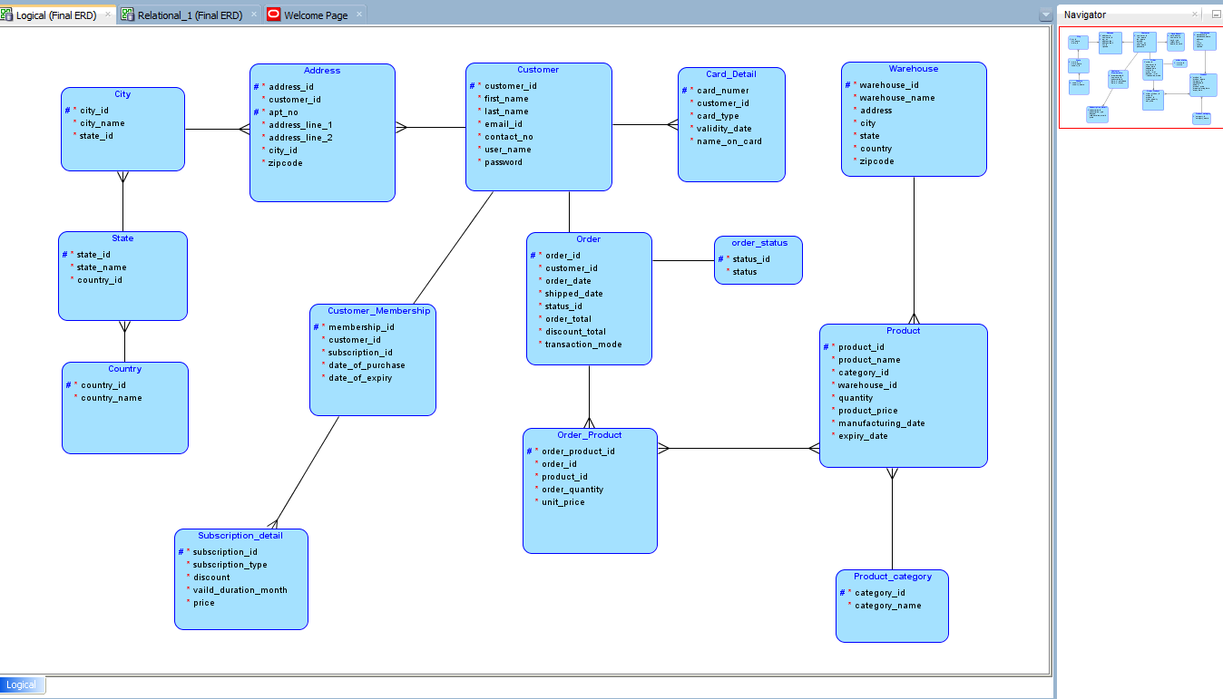
DATA MODEL E-R DIAGRAM

Slide 7
Demonstration

Slide 8
Thank You

